Slide 1
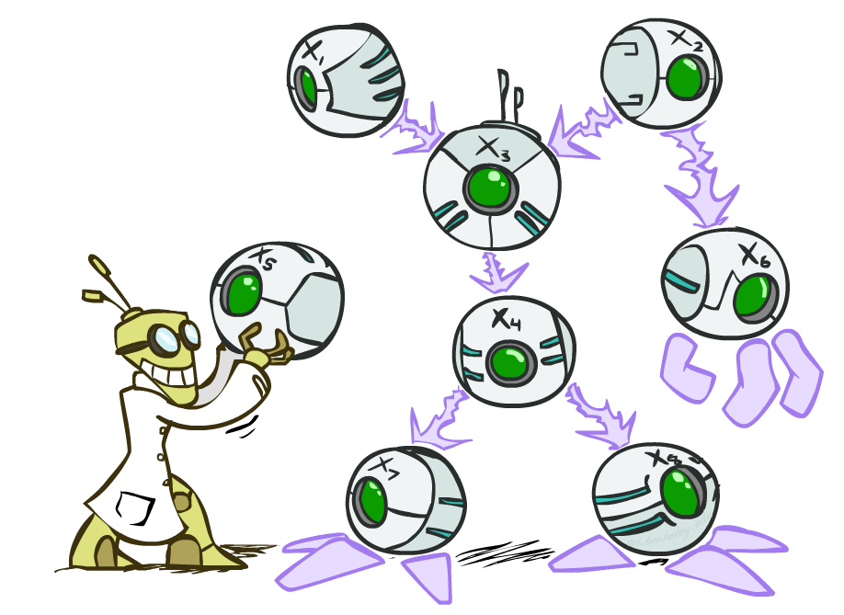
Artificial Intelligence
Probabilistic Reasoning with Bayes Nets
CS 444 – Spring 2021
Dr. Kevin Molloy
Department of Computer Science
James Madison University
Much of this lecture is taken from
AIMA resources

Slide 2

Probabilistic Models
Models describe how (a portion of) the world works
Models are always simplifications
May not account for every variable
May not account for all interactions between variables
“All models are wrong; but some are useful.” – George E. P. Box
What do we do with probabilistic models?
We (or our agents) need to reason about unknown variables, given evidence
Example: explanation (diagnostic reasoning)
Example: prediction (causal reasoning)
Example: value of information

Slide 3
Bayesian Networks
A simple, graphical notation for conditional independence assertions and hence for compact specification of full joint distribution
Syntax:
A set of nodes, one per variable
A directed, acyclic graph (link is approximately "directly influences")
a conditional distribution for each node given its parents P(X_{i} | Parents(X_{i})).
In the simplest case, conditional distribution represented as a conditional probability table (CPT) giving the distribution over X_{i} for each combination of parents values.

Slide 4

Example of a Bayesian Network
Topology of network encodes conditional independence assertions:
P(Toothache, Cavity, Catch)
If I have a cavity, the probability that the probe catches in it doesn't depend on whether I have a toothache:
P(+catch | +toothache, +cavity) = P(+catch | +cavity)
The same independence holds if I don’t have a cavity:
P(+catch | +toothache, -cavity) = P(+catch| -cavity)
Catch is conditionally independent of Toothache given Cavity:
P(Catch | Toothache, Cavity) = P(Catch | Cavity)

Slide 5
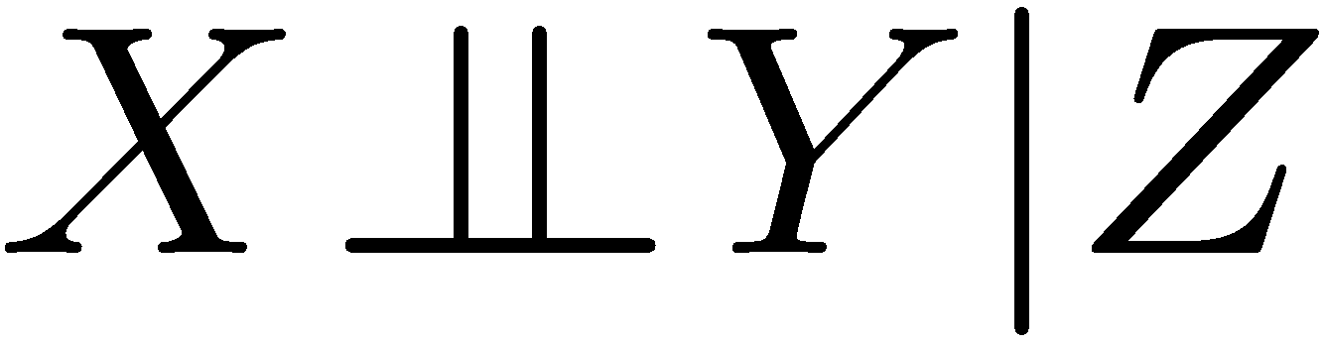
Conditional Independence
Unconditional (absolute) independence very rare (why?)
Conditional independence is our most basic and robust form of knowledge about uncertain environments.
X is conditionally independent of Y given Z
if and only if:
or, equivalently, if and only if

Slide 6
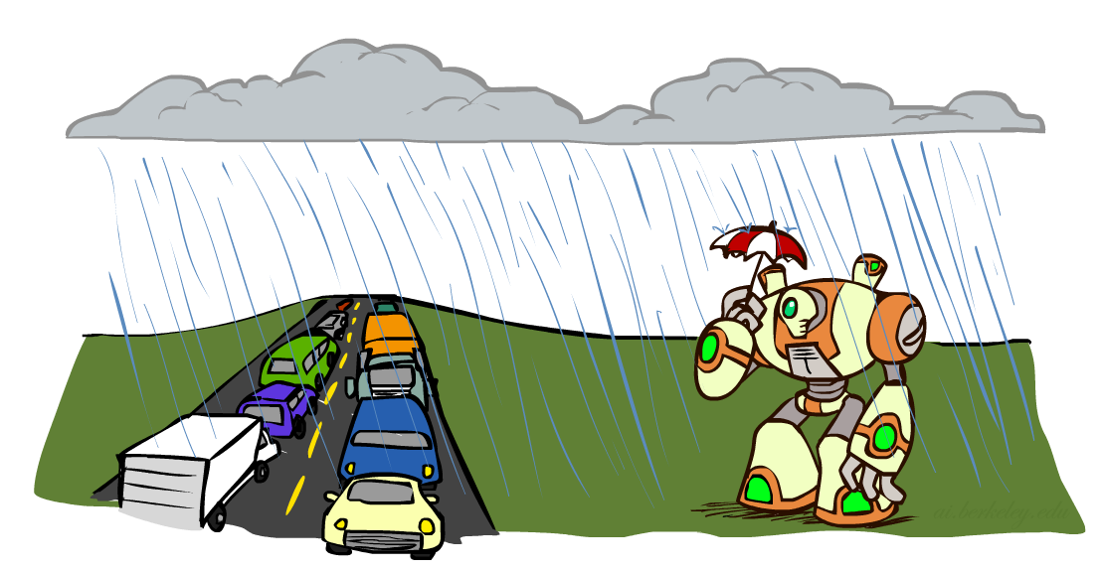
Short Quiz: Conditional Independence
What about this domain:
Traffic
Umbrella
Raining

Slide 7
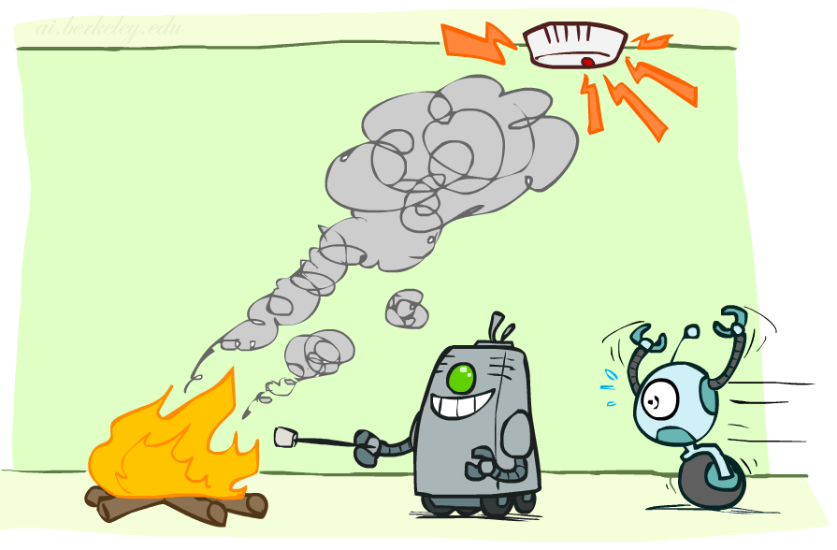
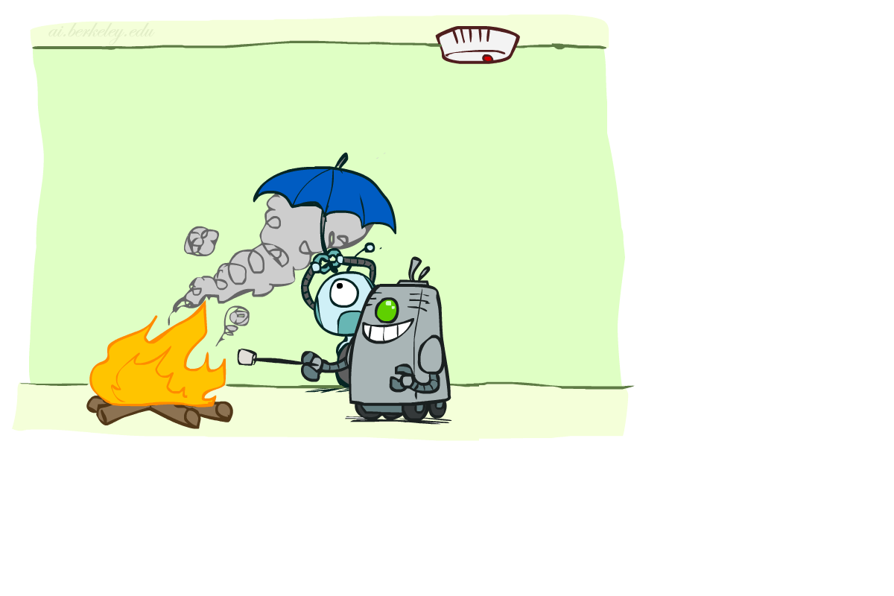
Short Quiz: Conditional Independence
What about this domain:
Fire
Smoke
Alarm

Slide 8

Conditional Ind. And the Chain Rule
Chain rule:
Trivial decomposition:
With assumption of conditional independence:
Bayes’nets / graphical models help us express conditional independence assumptions

Slide 9


Ghostbusters Chain Rule
Each sensor depends only on where the ghost is
That means, the two sensors are conditionally independent, given the ghost position
T: Top square is red B: Bottom square is red G: Ghost is in the top
Givens:
P( +g ) = 0.5
P( -g ) = 0.5
P( +t | +g ) = 0.8 P( +t | -g ) = 0.4 P( +b | +g ) = 0.4 P( +b | -g ) = 0.8
P(T,B,G) = P(G) P(T|G) P(B|G)

Slide 10


Big Picture of Bayes' Nets
Two problems with using full joint distribution tables as our probabilistic models:
Unless there are only a few variables, the joint is WAY too big to represent explicitly
Hard to learn (estimate) anything empirically about more than a few variables at a time
Bayes’ nets: a technique for describing complex joint distributions (models) using simple, local distributions (conditional probabilities)
More properly called graphical models
We describe how variables locally interact
Local interactions chain together to give global, indirect interactions
For about 10 min, we’ll be vague about how these interactions are specified

Slide 11
Example Car Diagnosis
Initial evidence: car won't start
Testable variables (Green), "Broken, so fix it" variables are orange
Hidden variables (gray) ensure sparse structure, reduce parameters

Slide 12
Example: Car Insurance

Slide 13
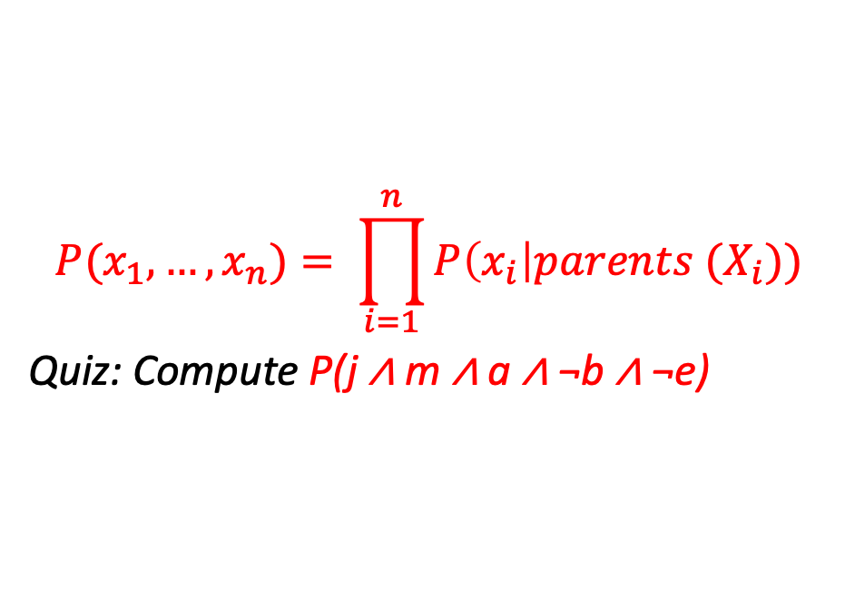
Global Semantics
Global semantics defines the full joint distribution as the product of the local conditional distributions.
$$P(x_{1}, …,x_{n})= \prod_{i=1}^{n}{P\left(x_{i}\right|parents (X_{i}))}$$
Quiz: Compute P(j ∧ m ∧ a ∧ ¬b ∧ ¬e)
= P(j |a )P(M | a) P (a | ¬b, ¬e)P(¬b) P(¬e)
= 0.9 x 0.7 x 0.001 x 0.999 x .998
≈ 0.00063

Slide 14
Local Semantics
Local semantics: each node is conditionally independent of its nondescenants given its parents
Theorem: Local semantics ⇔ global semantics

Slide 15

Example: Coin Flips
N independent coin flips
No interactions between variables: absolute independence
X₁
X₂
X_{n}

Slide 16
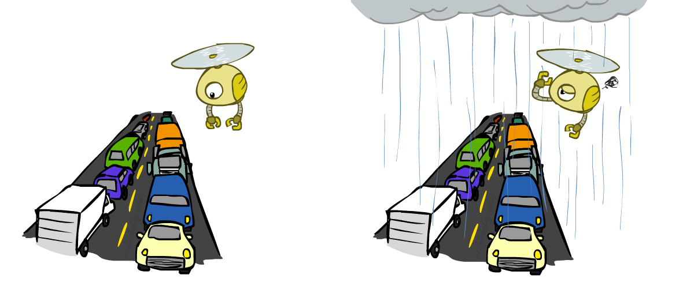
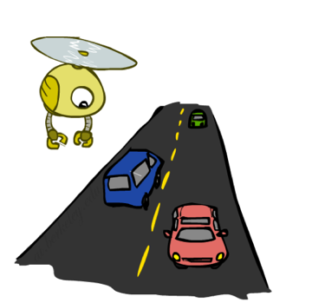
Example: Traffic
Variables:
R: It rains
T: There is traffic
Model 1: independence
Why is an agent using model 2 better?
R
R
T
T

Slide 17
Example of a Bayesian Network
I'm at work, neighbor John calls to say my burglar alarm is ringing, but my neighbor Mary doesn't call. Sometimes the alarm is set off by earthquakes. Is there a burglar?
Variables: Burglar, Earthquake, Alarm, JohnCalls, MaryCalls
Network topology reflects "causal" knowledge:
A burglar can set off the alarm
An earthquake can set the alarm off
The alarm can cause Mary to call
The alarm can cause John to Call.

Slide 18
Example Bayesian Network

Slide 19
Compactness
A CPT for Boolean X_{i} with k Boolean parents.
Has:
2^{k} rows for the combinations of parent values
Each row requires on number p for X_{i} = true
(the number for X_{i} = false is simply 1 – p)
If each variable has no more than k parents, the complete network requires O(n ∙ 2^{k}) numbers
i.e. grows linearly with n, vs O(2^{n}) for the full joint distribution.
For the burglary net, 1 + 1 + 4 + 2 + 2 = 10 numbers (vs. 2⁵ – 1 = 31).

Slide 20
In-Class Problem
We have a bag of 3 biased coins: a, b, c with probabilities of coming up heads of 20%, 60%, and 80% respectively. One coin is drawn randomly from the bag (with equal likelihood od drawing each of the 3 coins), and then the coin is flipped 3 times to generate the outcomes X₁, X₂, and X₃.
Draw the Bayesian network corresponding to this setup and define the necessary CPTs.
Calculate which coin was most likely to have been drawn from the bag if the observed flips come out heads twice and tails once.

